Slide 1
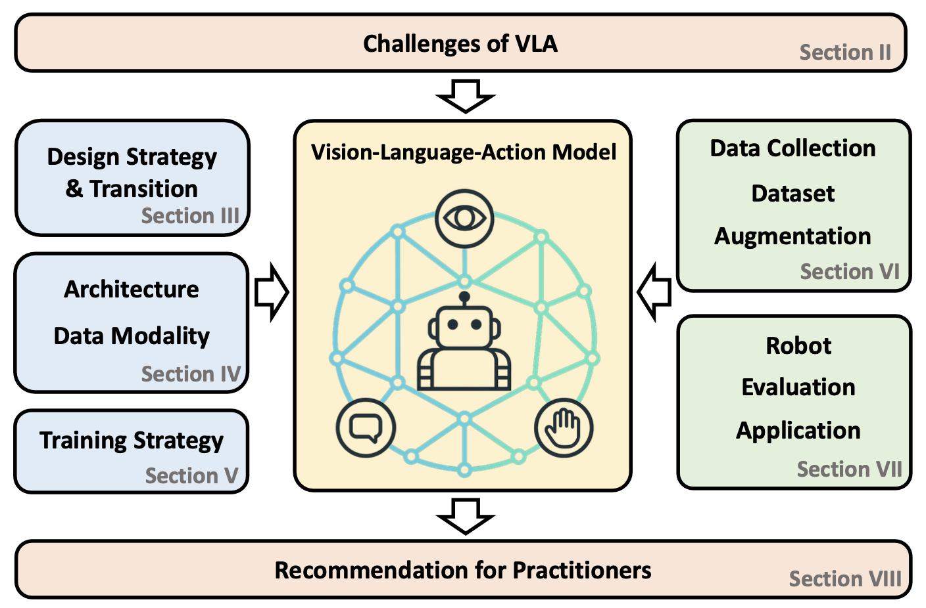
01
Vision-Language-Action models (VLAs): What, Why, How?
• VLAs is a system that takes visual observations and natural language instructions as required inputs and may incorporate additional sensory modalities. It produces robot actions by directly generating control commands.
• VLAs aim to enable robots to perform a wider range of tasks and facilitate effective transfer across varying robotic embodiments.
• Jointly learning visual, linguistic, and action modalities in an end-to-end framework with different architectural and training methodologies.
Vision
Language
Action
Vision-Language-Action Models for Robotics: A Review Towards Real-World Applications

Slide 2

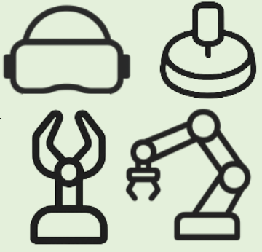

02
Challenges
• Data availability: datasets satisfying all three modalities are limited in both scale and diversity.
• Embodiment mismatches: each robot typically operates in a distinct action space and proprioceptive observation space, reflecting differences in degrees of freedom, sensor modalities, and kinematic structure.
• Computational constraints: training VLA models entails a considerable amount of computational demands due to the high-dimensional and multi-modal nature of their input.
Vision-Language-Action Models for Robotics: A Review Towards Real-World Applications

Slide 3
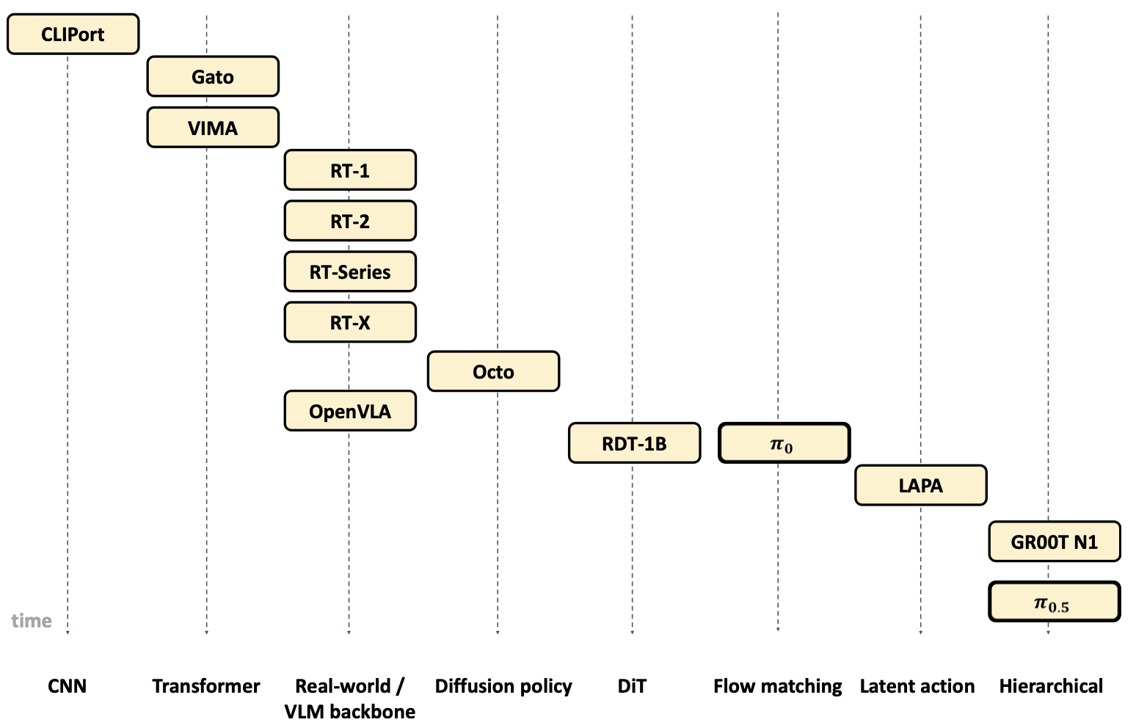
03
Current Status
2022
• Research on VLAs remains in its early stages. Architectural and training methodologies are not yet standardized.
Now
Different architecture
Vision-Language-Action Models for Robotics: A Review Towards Real-World Applications

Slide 4
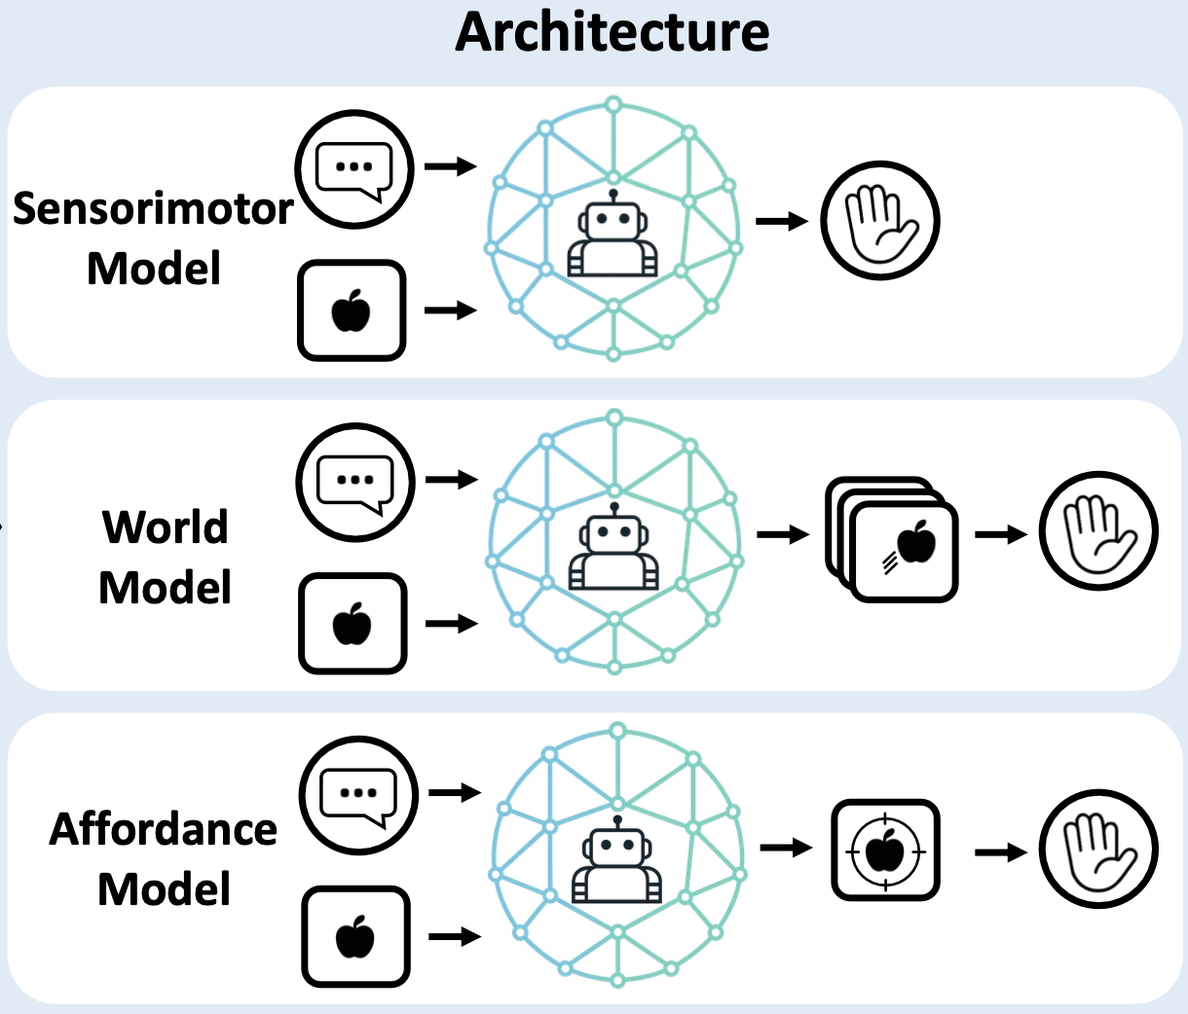
04
Architectures
• Sensorimotor model: directly output actions.
• World model: predict the future evolution of visual modalities and use these predictions to guide action generation
• Affordance model: predict action-relevant visual affordances based on language and then generate actions accordingly.
Vision-Language-Action Models for Robotics: A Review Towards Real-World Applications

Slide 5
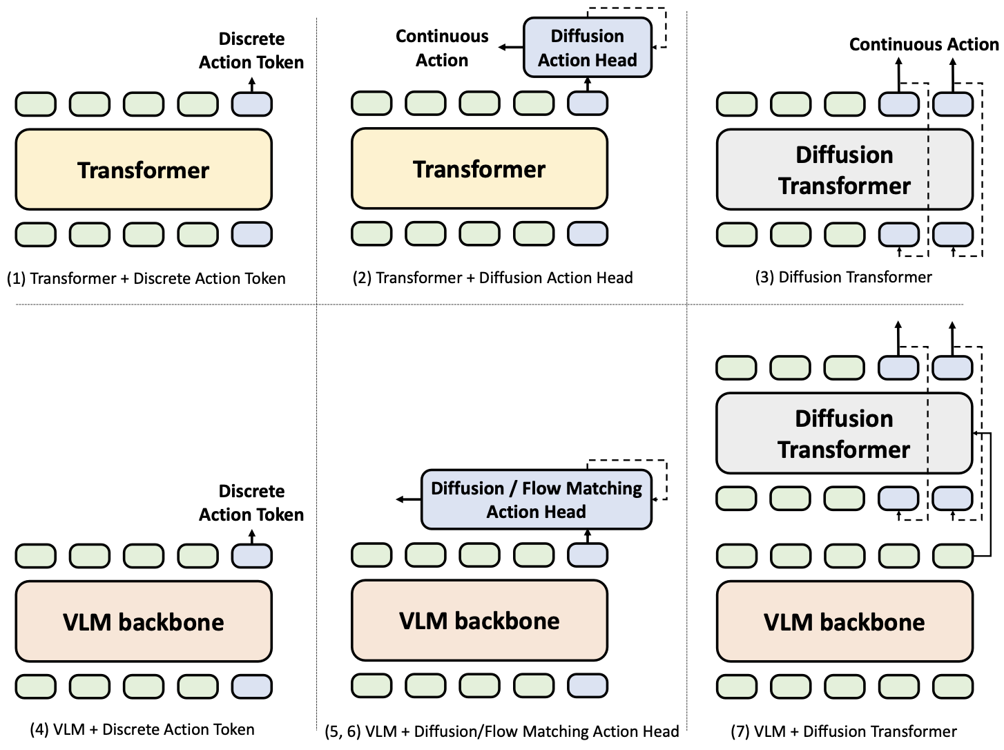
05
Architectures: Sensorimotor model
• From Discrete Action Token to Continuous Action: discrete action tokens often lack real-time responsiveness and smoothness, and diffusion models achieve continuous and stable action outputs.
• Leveraging VLM pre-trained on large-scale internet data: allows these models to incorporate human commonsense knowledge and benefit from in-context learning capabilities.
• VLM + Diffusion Transformer: the VLM typically serves as a high-level policy, while the diffusion transformer acts as a low-level policy
Vision-Language-Action Models for Robotics: A Review Towards Real-World Applications

Slide 6
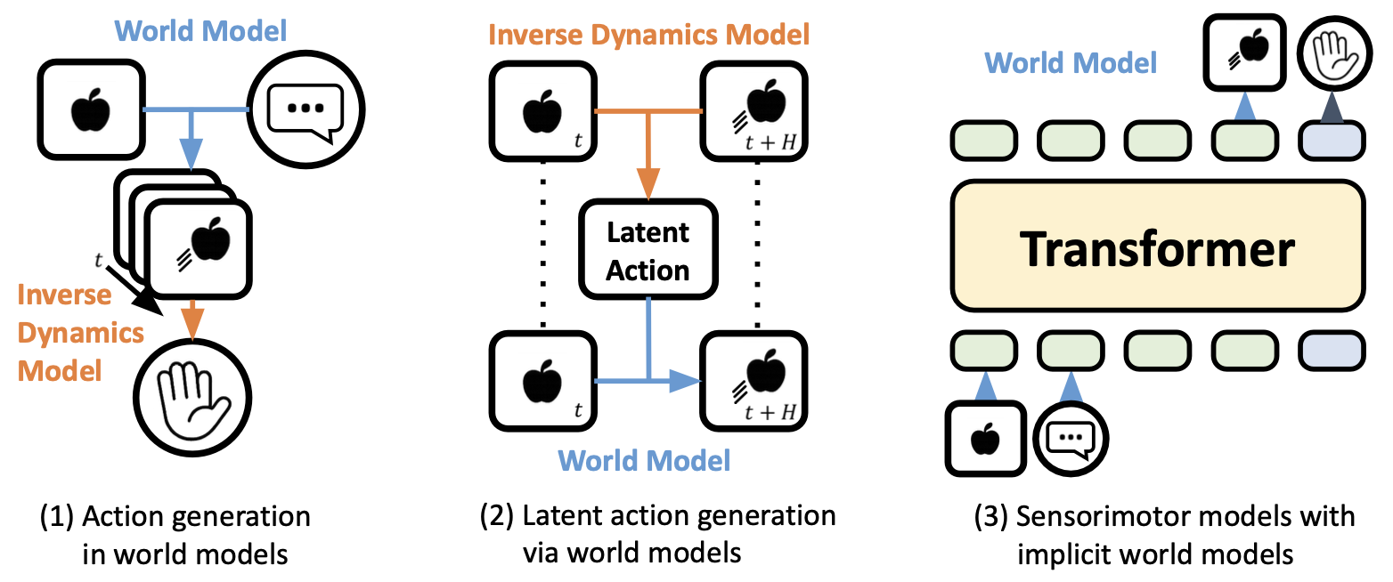
06
Architectures: World model
• IDM translates the predicted image sequence into low-level actions.
• Generate future frames conditioned on the current image and the latent action. (self-supervised)
• Jointly output both actions and predictions of future observations to improve performance
Vision-Language-Action Models for Robotics: A Review Towards Real-World Applications

Slide 7
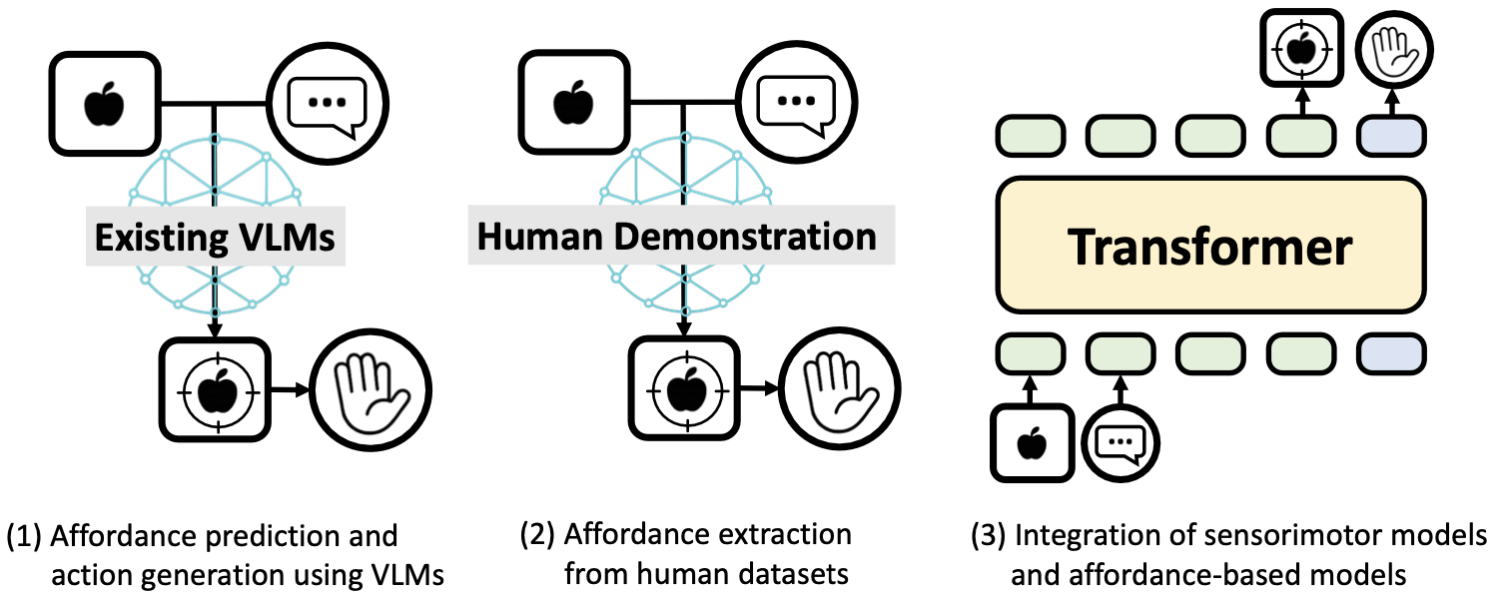
07
Architectures: Affordance model
“An affordance is a relationship between an actor, an object, and an action, defining what actions are feasible for the actor on that object in a given environment.”
• Predicting affordances and subsequently generating actions.
• Extracting affordances from human demonstration videos and learning latent representations to guide action generation
• Incorporating affordance prediction into VLA
Vision-Language-Action Models for Robotics: A Review Towards Real-World Applications

Slide 8
08
Architectures: Emerging directions
• Hierarchical architectures: Using existing VLMs as high-level policies to decompose task instructions into subtasks. These subtask descriptions are then passed to a VLA acting as the low-level policy.
• Chain-of-Thought (CoT) reasoning: introducing a step-by-step process between observations, instructions, and action generation, e.g. predicting task descriptions, subtasks, and object positions, before generating the final action sequence. (Broader concept)
Vision-Language-Action Models for Robotics: A Review Towards Real-World Applications

Slide 9

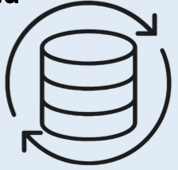
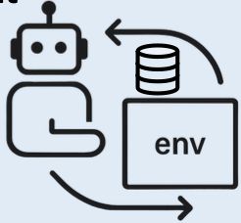
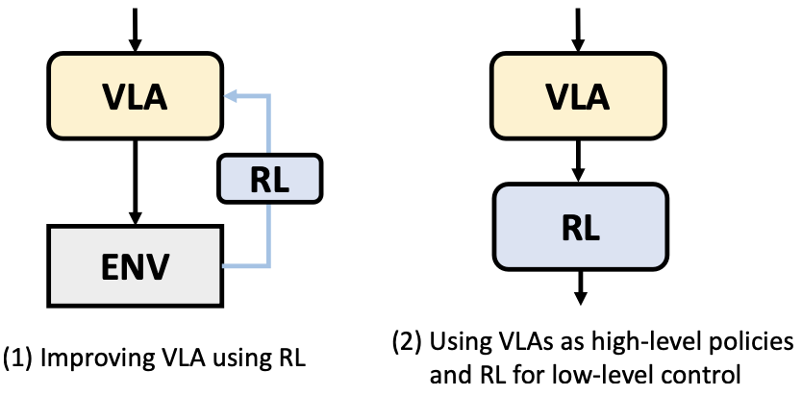
09
Training strategy
• Supervised learning: training is often formulated as a next-token prediction task with pairs of images, language, and actions. Typically pre-training the VLM backbone and finetuning the action head on high-quality, robot- and task- specific data.
• Self-supervised learning: serving three main purposes, Modality alignment, Visual representation learning, Latent action representation learning.
• Reinforcement learning:
Vision-Language-Action Models for Robotics: A Review Towards Real-World Applications

Slide 10
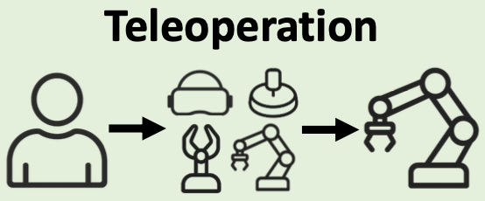
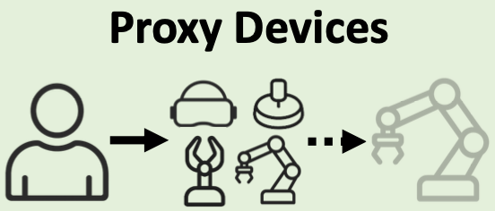

10
Data collection
• Demonstrations are recorded in real time while a human operator directly controls the robot, enabling the collection of high-quality trajectories.
• More intuitive, flexible, and scalable data collection through the use of proxy devices. For example, a handheld gripper equipped with a GoPro camera.
• Collecting data by recording natural human behavior without relying on proxy devices.
Vision-Language-Action Models for Robotics: A Review Towards Real-World Applications

Slide 11
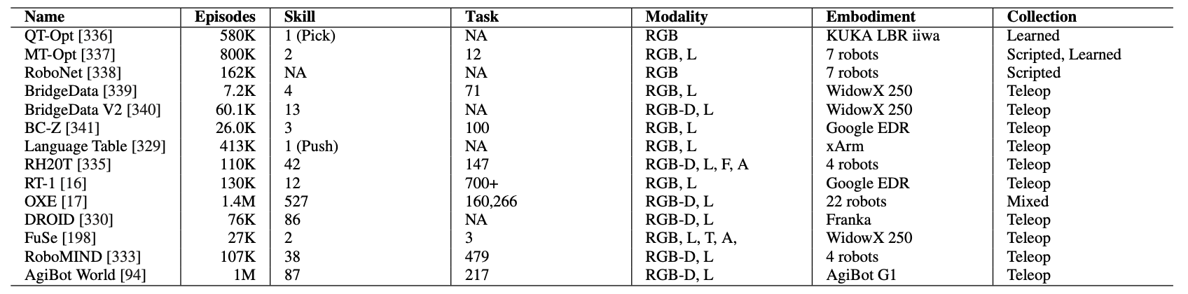
11
Datasets
• Human datasets: more scalable, the advent of smart-glass-based recording devices has enabled more naturalistic and unobtrusive egocentric data collection.
• Simulation datasets: scalable, safe, and cost-effective.
• Real robot datasets:
Diverse skills, tasks, robots; limited action modalities; mostly based on teleoperation
Vision-Language-Action Models for Robotics: A Review Towards Real-World Applications

Slide 12
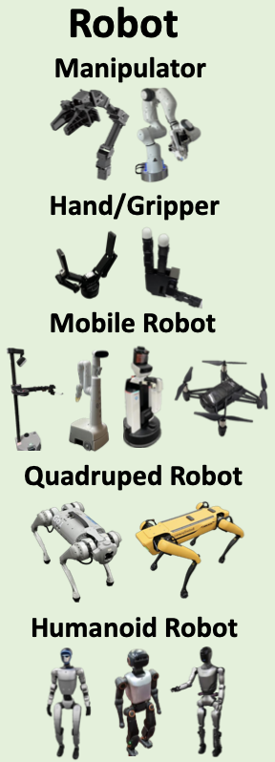
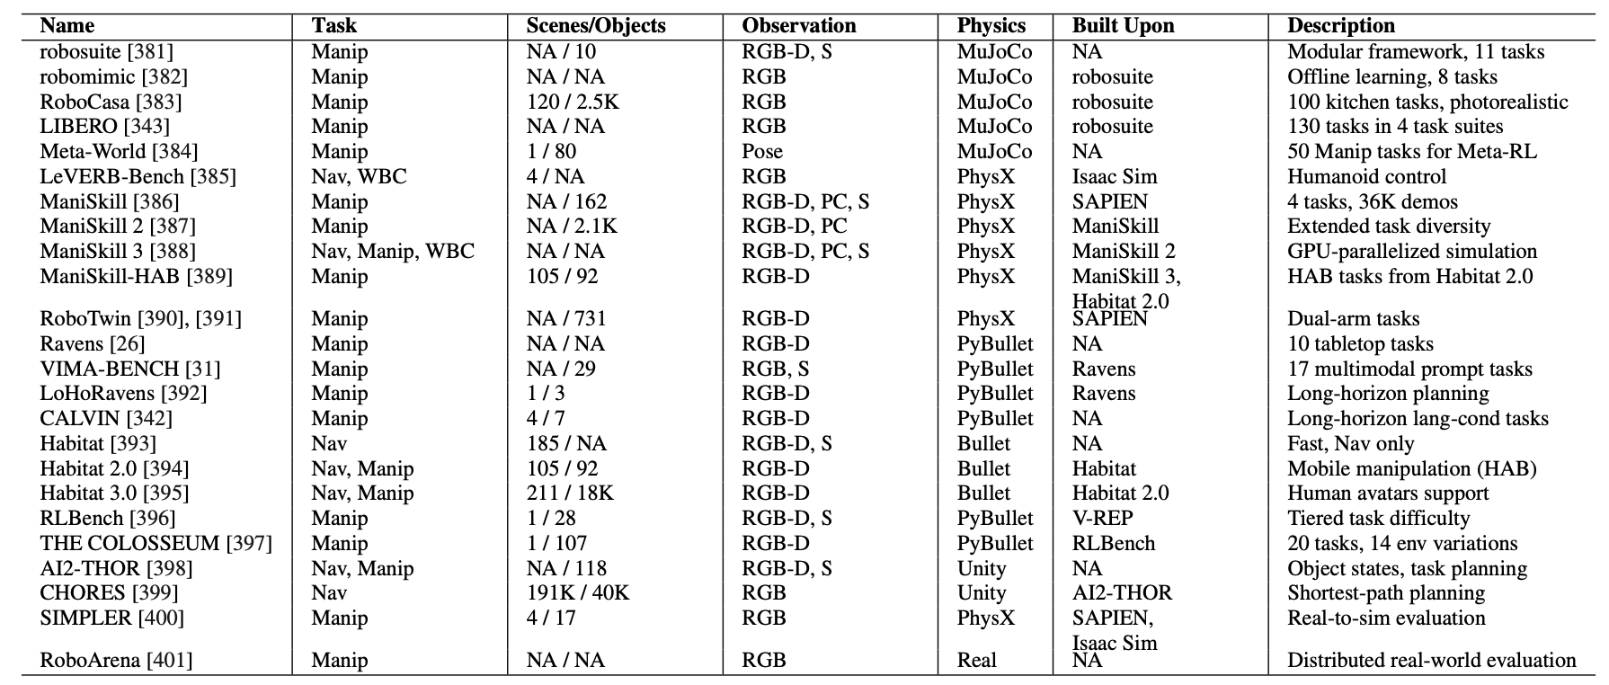
12
Application & Evaluation
Different robotic platforms
Benchmarks
• Evaluation metrics for VLA models remain poorly defined, particularly in real-world settings.
• Assessing generalization on physical robots is challenging due to differences in embodiment, safety concerns, and limited reproducibility.
• Most evaluations are conducted in simulation.
Vision-Language-Action Models for Robotics: A Review Towards Real-World Applications

Slide 13
13
Future directions
• More data modalities: audio, tactile sensing, 3D point clouds, etc.
• Long-horizon tasks: reasoning, maintaining a form of memory, selectively attending to key information that supports decision-making.
• Continual learning: VLA systems remain fixed, making them vulnerable when faced with novel or out-of-distribution scenarios.
• Safety: current systems often lack mechanisms to detect and avoid unexpected human presence in the workspace, increasing the risk of collisions.
• Failure detection: current VLA systems lack mechanisms for detecting unexpected failures or responding appropriately.
Vision-Language-Action Models for Robotics: A Review Towards Real-World Applications

